Slide 1
Design Patterns Glossary
arnaud.nauwynck@gmail.com

Slide 2
Reminder UML
Class A extends SuperClass
Class A implements ISupport
SuperClass
ISupport
extends
implements
A
Relationship to
(pointer/collection field)
fieldB
D
fieldC
B
// reference to 0 or 1 B … nullable pointer
private B fieldB;
1
0..1
// either lookup or create
public D ableToReturnD();
ChildClass
C
// reference to any number of C private List<C> fieldC = new ArrayList<>();
0..*
// A has strong aggregation (ownership) on Child
// when destroying A, Child are destroyed
private ChildClass child = new ChildClass();

Slide 3
Fundamental Principle : SOLID https://en.wikipedia.org/wiki/SOLID
S ingle
O open-closed
L iskov susbtitution principle
I nterface seggregation
D ependency inversion

Slide 4
Inheritance Principle
Do not inherit code…
only abstract method
( can not inherit from multiple classes)
Use Delegation instead of Inheritance

Slide 5
3 Categories of Design Patterns
Creational Patterns
Structural Patterns
Behavioral Patterns

Slide 6
Part 1 : Creational Patterns
Abstract Factory (Kit)
Builder
Factory Method
Prototype
Singleton
Not in Gof:
Dependency Injection

Slide 7
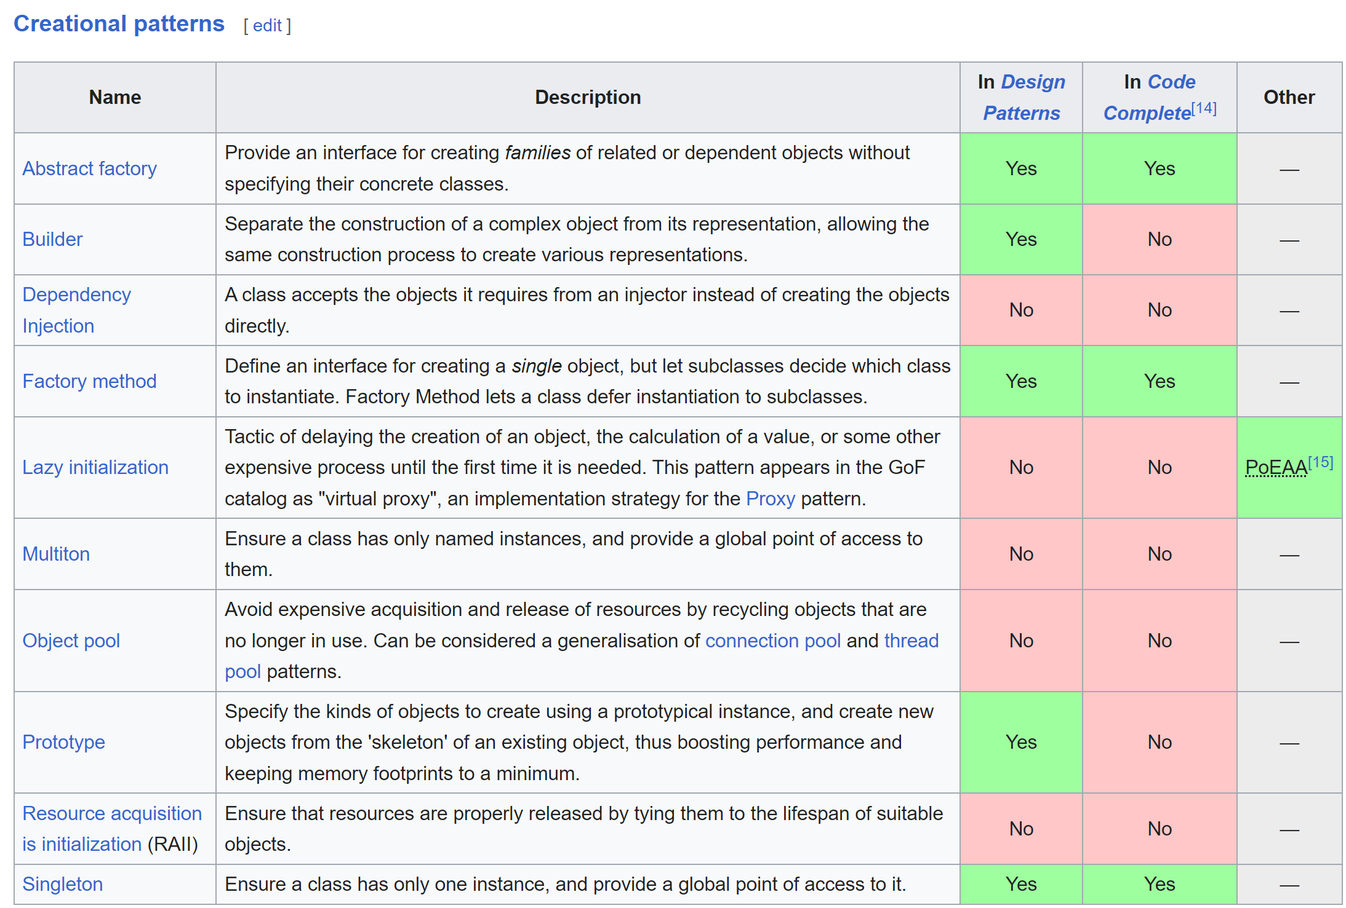
Creational Patterns..(Wikipedia) https://en.wikipedia.org/wiki/Software_design_pattern

Slide 8
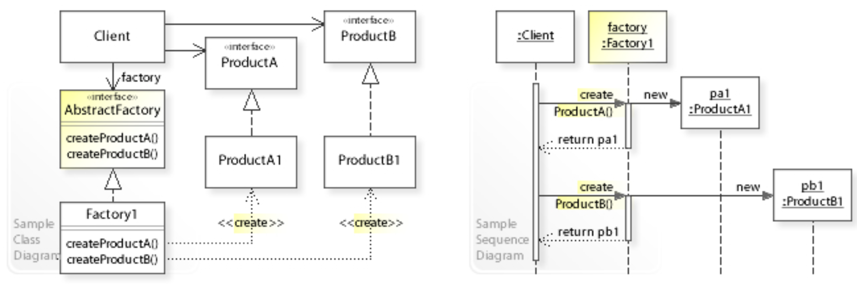
Abstract Factory Kit
Provide an interface for creating families of related or dependent objects without specifying their concrete classes.

Slide 9
Abstract Factory Kit
A
AbstractFactoryKit
A createA()
B createB()
A1
A2
FactoryKit1
FactoryKit2
B
B1
B2
Family « 1 »
For A,B
Family « 2 »
For A,B

Slide 10
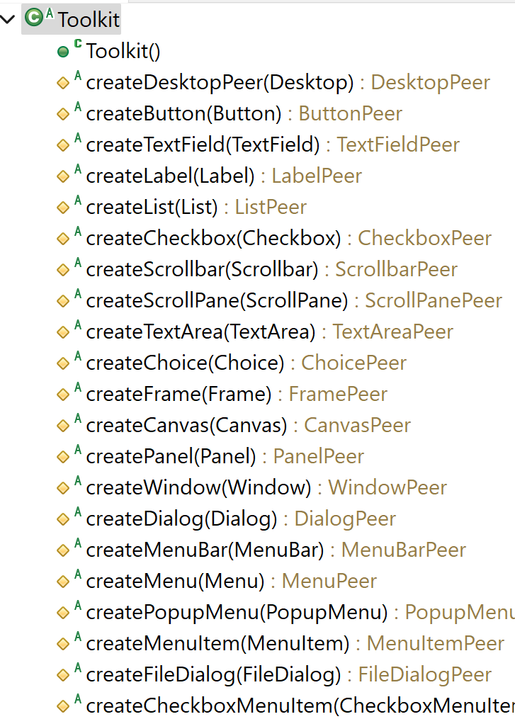
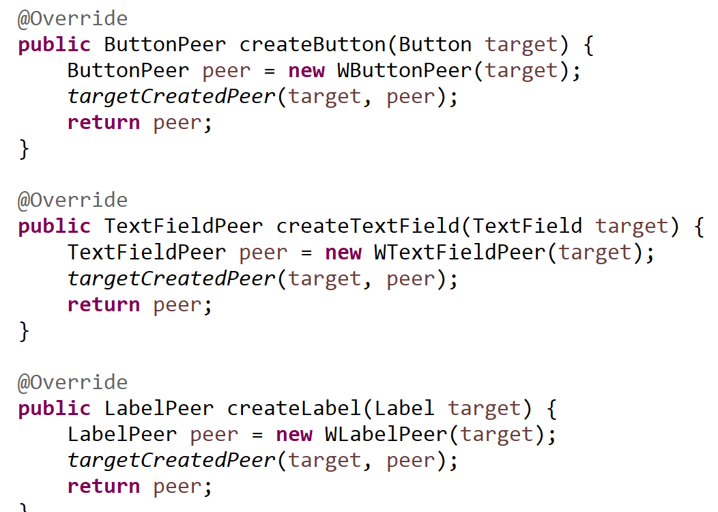
Example AbstractFactory Kit
In java awt …
« java.awt.Toolkit »
… to support different
Systems:
Unix, Windows,Mac, ..
Windows implementation:
class Wtoolkit extends Toolkit {

Slide 11
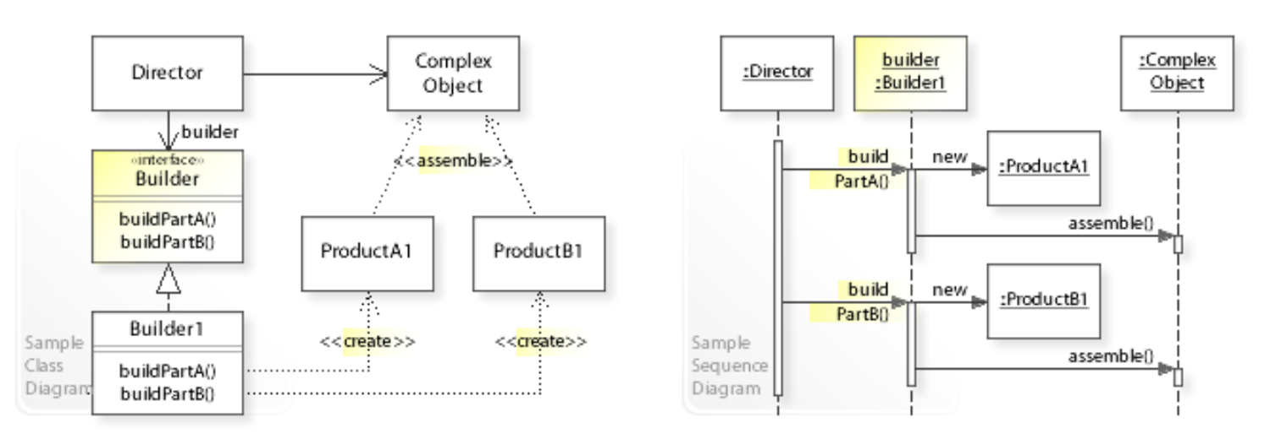
Builder
Separate the construction of a complex object from its representation,
allowing the same construction process to create various representations.

Slide 12
@Builder in Lombok temporary object for building an immutable one
class ImmutableA {
private final int field1, field2 ….
protected ImmutableA(ImmutableABuilder b){ this.field1 = b.field1;
this.field2 = b.field2; this.field3 = b.field3;
}
public static Builder builder() {
return new Builder();
}
}
@Builder
class ImmutableA {
private final int field1;
private final int field2;
private final int field3;
}
public static class Builder {
private int field1, field2, field3; // ⬅ NOT final !!!
public Builder field1(int p) { this.field1 = p; return this;}
public Builder field2(int p) { this.field2 = p; return this;}
public ImmutableA build() {
return new ImmutableA(this); // or equivalently new..(field1, field2, field3, ….);
}
}

Slide 13
Sample @Builder usage
Fluent API for building objects…
Each value is self-described
A a = A.builder() .field1 ( 10 ) .field2 ( 5 ) .field3 ( 32 ) .field4 ( 8 ) .build();
Is much more obvious than
A a = new A( 10, // for field1 5, 32, // for field3
8 );
Does not compile for immutable
A a = new A(); // ERR .. missing params a.field1 = 10; a.field2 = 5; a.field3 = 32;
a.field4 = 8;

Slide 14
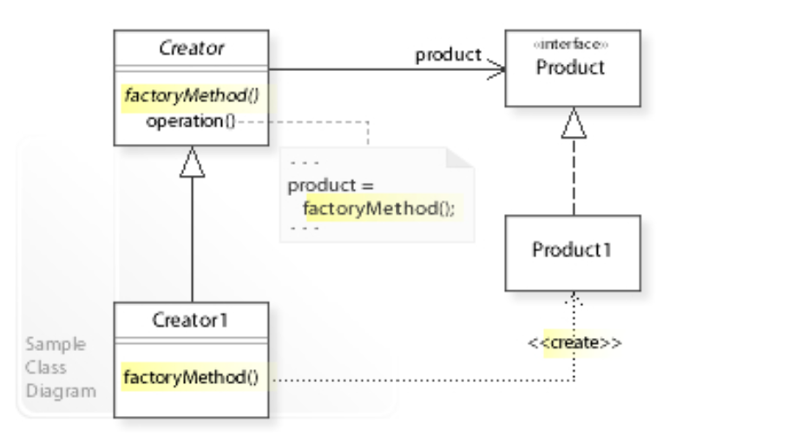
Factory Method
Define an interface for creating a single object, but let subclasses decide which class to instantiate.
Factory Method lets a class defer instantiation to subclasses.

Slide 15
Synonyms
Supplier
Provider
Factory Method
Create Function
Generator
Allocator

Slide 16
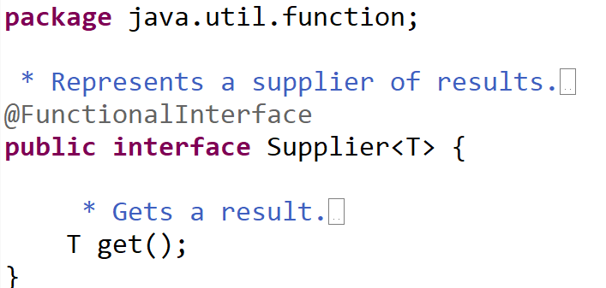
Example
Instead of
abstract class A {
protected abstract B createB();
// other methods for using new Bs
}
« Delegate instead of Extends »
class A {
protected final Supplier<B> bCreateFunction; public A(Supplier<B> bCreateFunction) {
this.bCreateFunction = bCreateFunction; }
// other methods for using new Bs
}

Slide 17
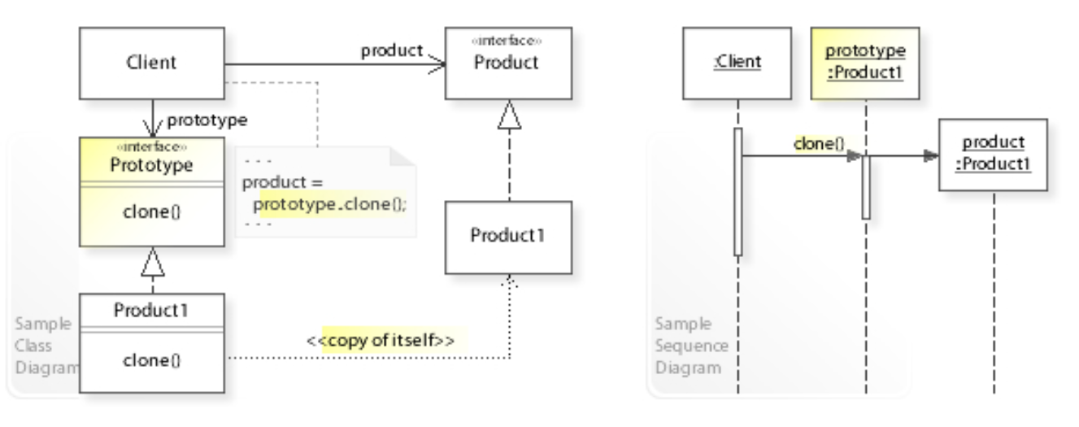
Prototype
Create object using « existingObjectInstance.clone() » instead of « new Class()»

Slide 18
Dependency Injection
A class accepts the objects it requires from an injector
instead of creating the objects directly.
Synonyms :
- “DI”
- “IOC” Inversion Of Control - Hollywood Principle: “Don’t call me, I will call You”

Slide 19
Example
Massively used in all modern frameworks
Example SpringFramework / SpringBoot
Or using constructors + final…
@Service class MyService {
private final SomeService field1;
private final AnotherService field2;
@Autowired
public MyService( SomeService field1, ….) {
this.field1 = field1; this.field2 = field2; }
}
@Service class SomeService {
}
@Service class MyService {
@Autowired private SomeService field1;
@Autowired private AnotherService field2;
}
@Configuration class SomeServiceConfiguration {
@Bean public AnotherService bean() { return new … }
}

Slide 20
Part 2 : Structural Patterns

Slide 21
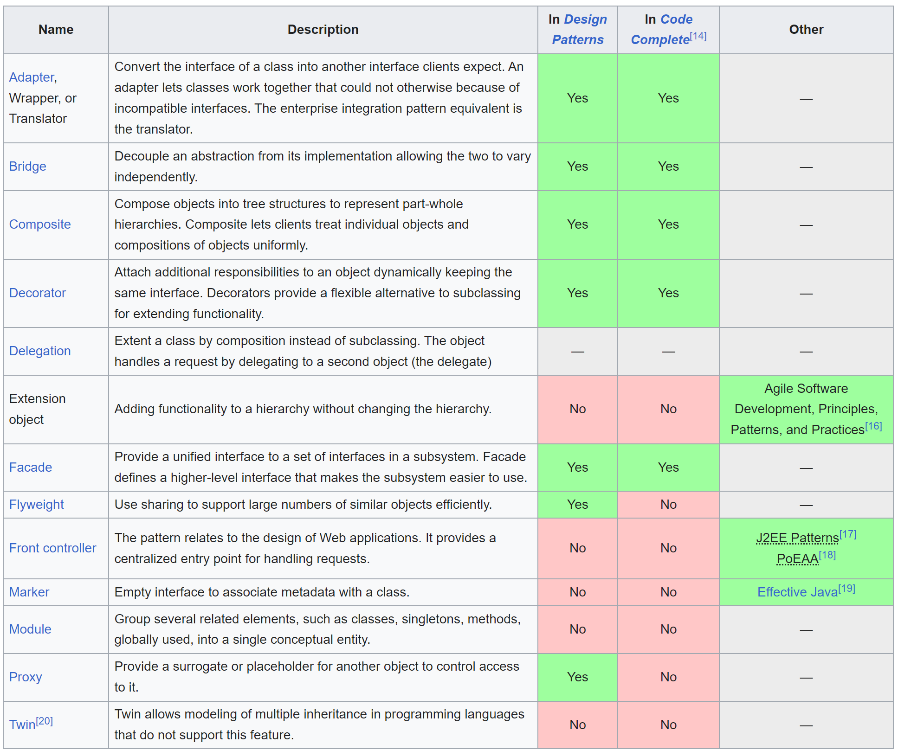

Slide 22
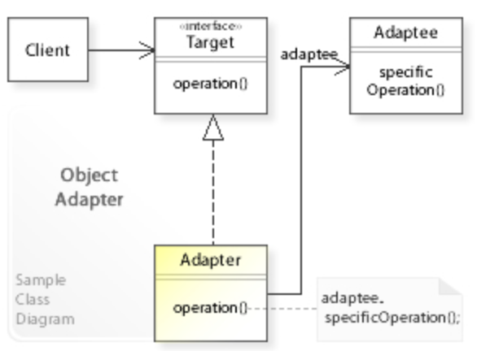
Adapter
Convert the interface of a class into another interface clients expect

Slide 23
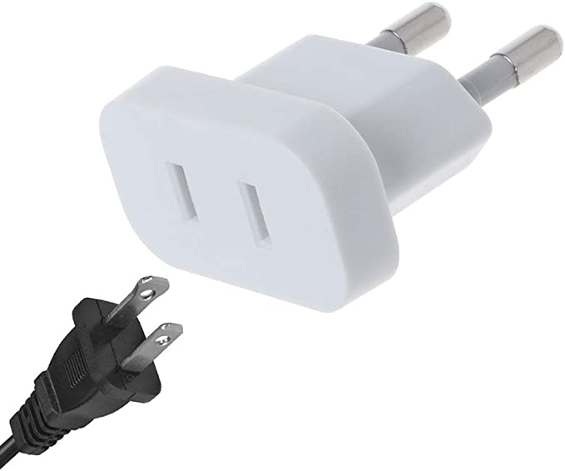
Example … travelling
Delegate to European electrical
Extends US electrical

Slide 24
Example … in compiler
// everything that can be wrapped in « { } »
// and appended by « ; »
// statement have NO type (i.e. void)
abstract class Statement {
}
// everything that can be wrapped in « ( ) »
// statement have a type
abstract class Expression {
}
1
// call an expression, to adapt it as a Statement
class ExprStatement extends Statement { private Expression expression;
}
f(x) + f(y) …. is an Expression
{ f(x) ; …. Is a sequence of Statements f(y) ; made of expressions (function call)
}

Slide 25
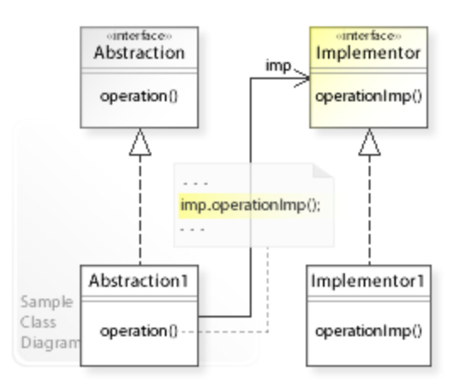
Bridge
Decouple an abstraction from its implementation
allowing the two to vary independently.

Slide 26

Synonym
StableApi
shock absorber
Isolation
InternalImpl
May changes
.. Should not impact

Slide 27
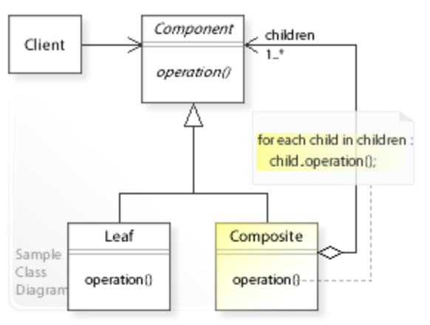
Composite
Compose objects into tree structures to represent part-whole hierarchies.
Composite lets clients treat individual objects and compositions of objects uniformly.

Slide 28
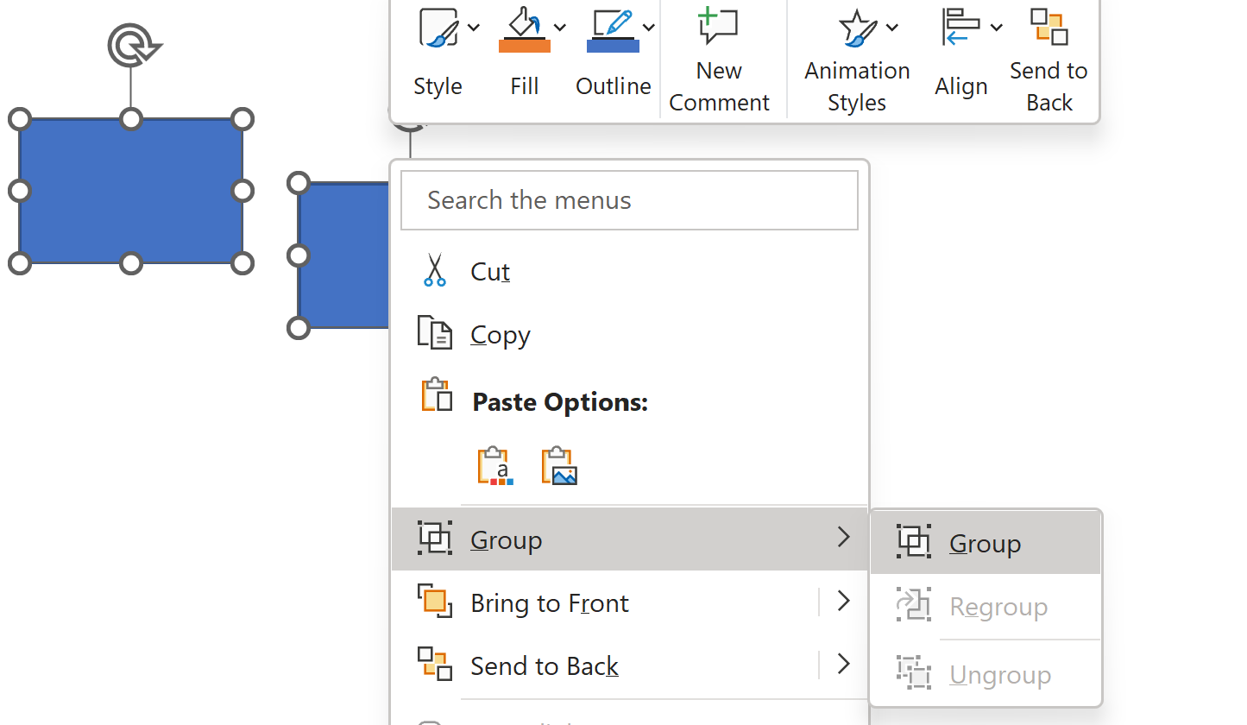
Example of Composite: a « Group » of graphical elements is itself a graphical element
On the « group »,
you can select, copy, translate, rotate,
change transparency, bring to front,…
( all commands )

Slide 29
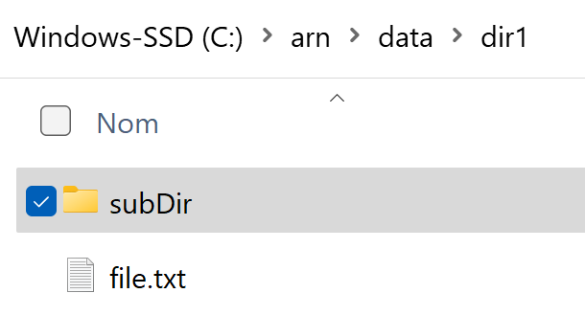
Examples of Composite
A Directory is a Composite of (sub-)directories and files
A directory is itself a filesystem element (=Inode), like file

Slide 30
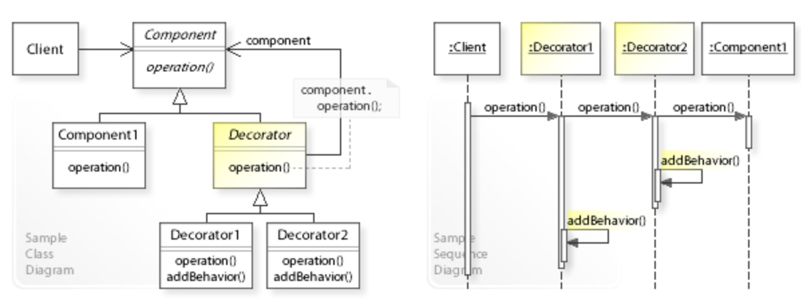
Decorator
Attach additional responsibilities to an object dynamically keeping the same interface.
Decorators provide a flexible alternative to subclassing for extending functionality.

Slide 31
Example Decorator
On graphical Element,
A « Border » graphical element -> add a border decoration to the underlying element
A « Shadowed » graphical element -> add a shadow decoration to the underlying element
On Aspect-Oriented-Programming,
A « Logged» method -> add a log, to the execution of a method
A « Timed Metric» method -> increment a statistic counter with the execution time

Slide 32
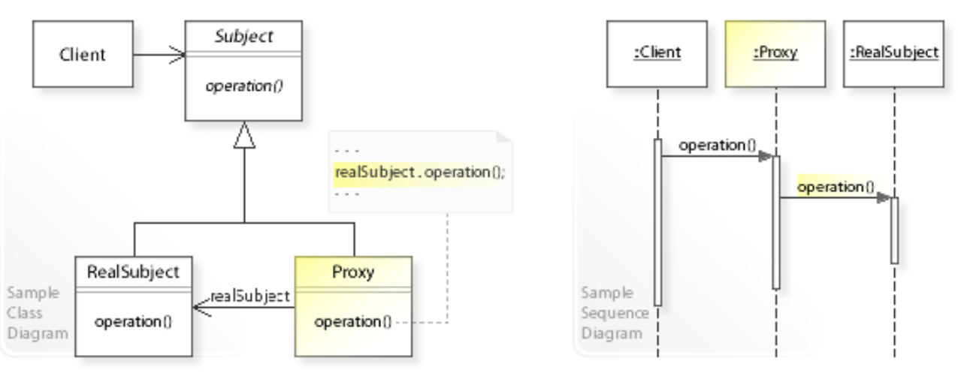
Proxy
Provide a surrogate or placeholder for another object to control access to it.

Slide 33
Synonyms
Indirection
Intermediate
Cache
Access through

Slide 34
Example http Proxy in networks..
Firewall
on Intranet company network
Internet
HTTP
Proxy
$ curl –p myproxy:8080 https://www.google.fr
1/ TCP connect to myproxy
+ send http request to myproxy, with extra http Header for « host »
=> 2/ the proxy rewrite another HTTP Request to host

Slide 35
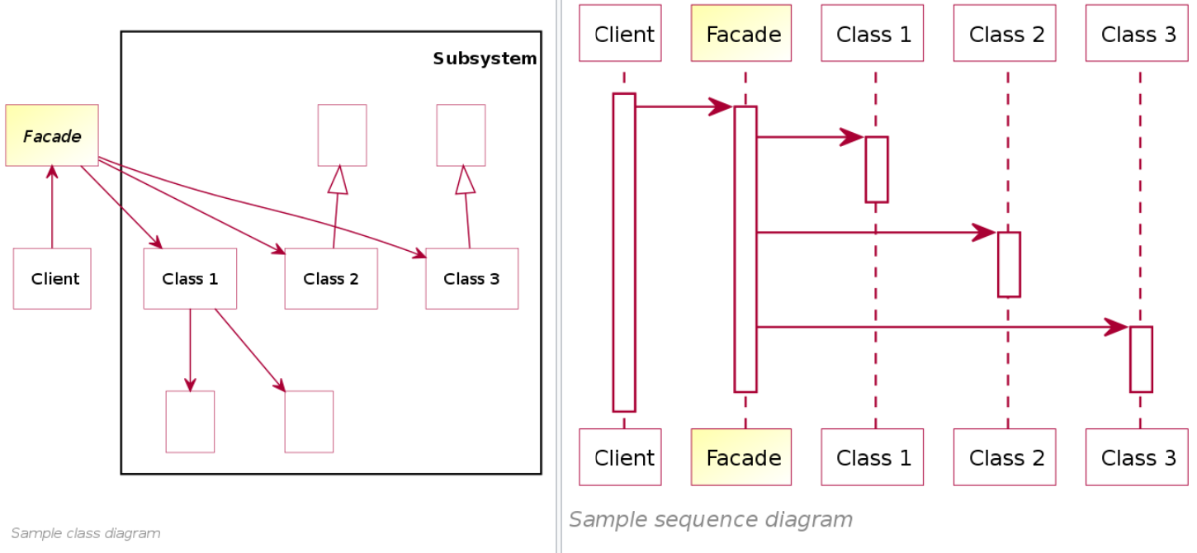
Facade
Provide a unified interface to a set of interfaces in a subsystem.
Facade defines a higher-level interface that makes the subsystem easier to use.

Slide 36
Examples … Network protocol layers
Service1
HttpRestController
Service2
DecoratorApi
(XA, Security, Logs)
ServiceFacadeApi
Service3
GraphqlController
Service4

Slide 37
Part 3 : Behavioral Patterns

Slide 38
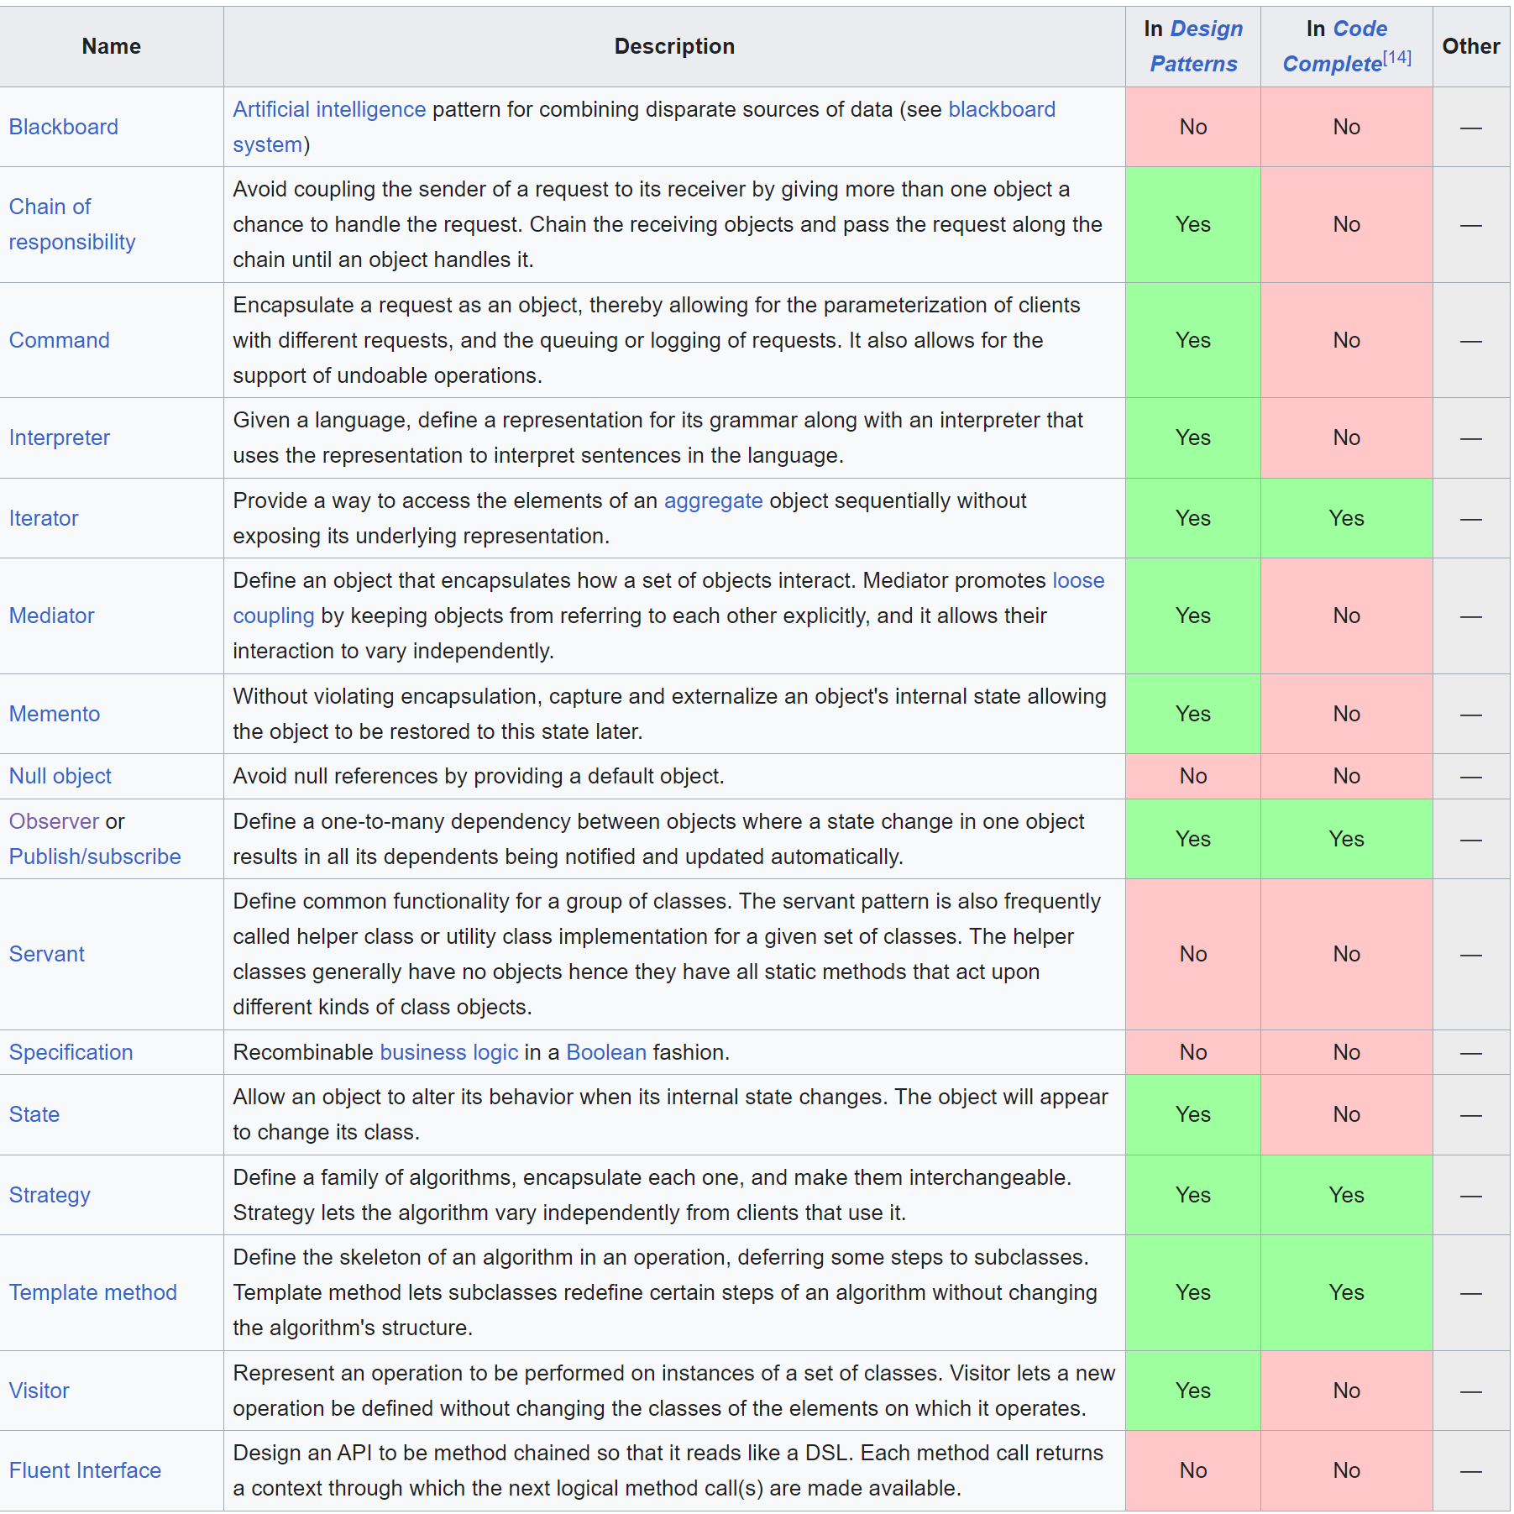

Slide 39
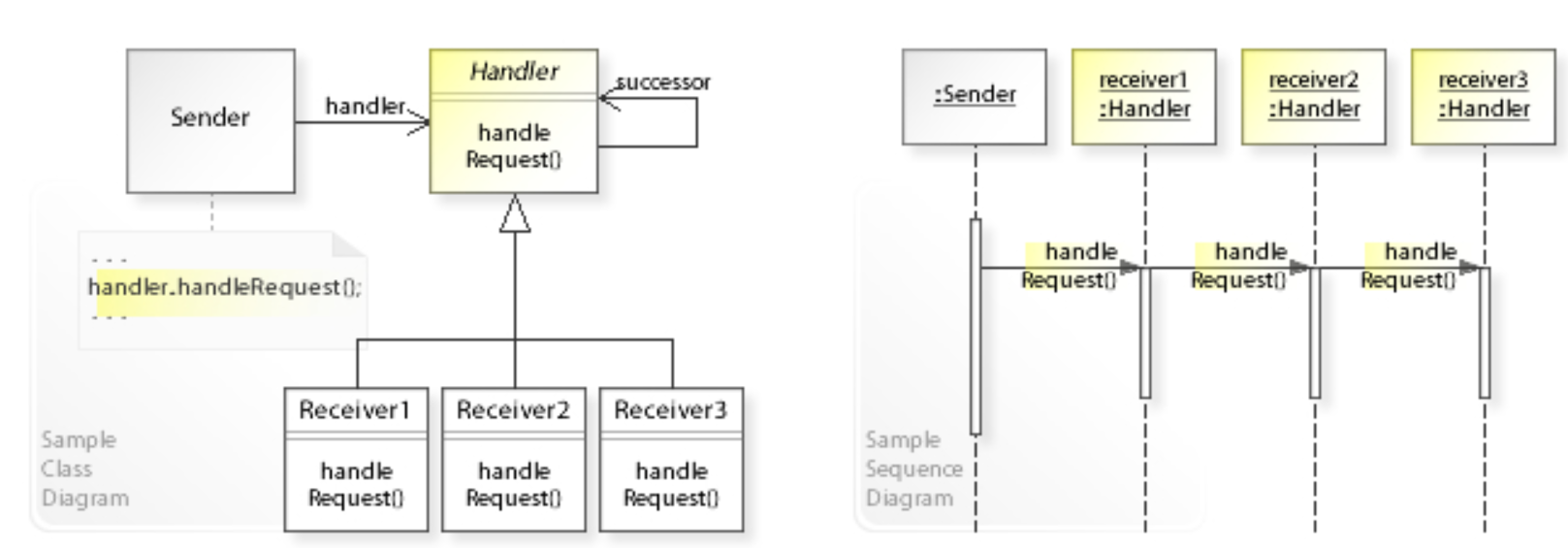
Chain of Responsability
Avoid coupling the sender of a request to its receiver
by giving more than one object a chance to handle the request.
Chain the receiving objects and pass the request along the chain until an object handles it.

Slide 40
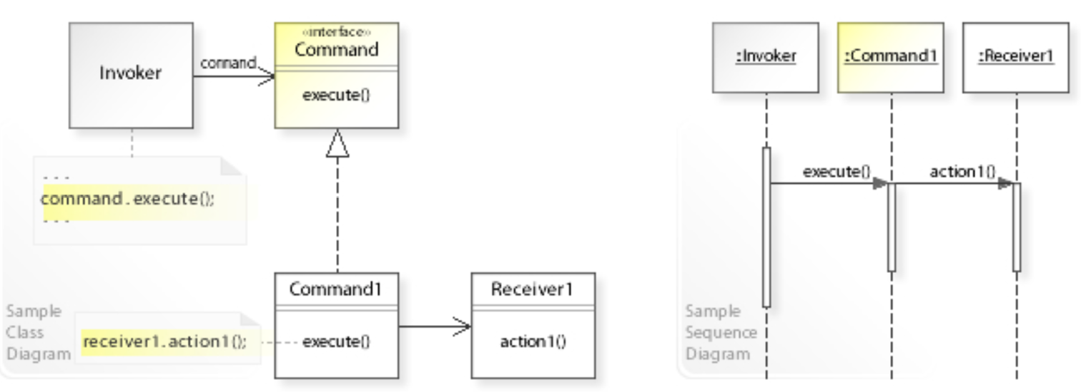
Command
Encapsulate a request as an object,
thereby allowing for the parameterization of clients with different requests,
and the queuing or logging of requests.
It also allows for the support of undoable operations.

Slide 41
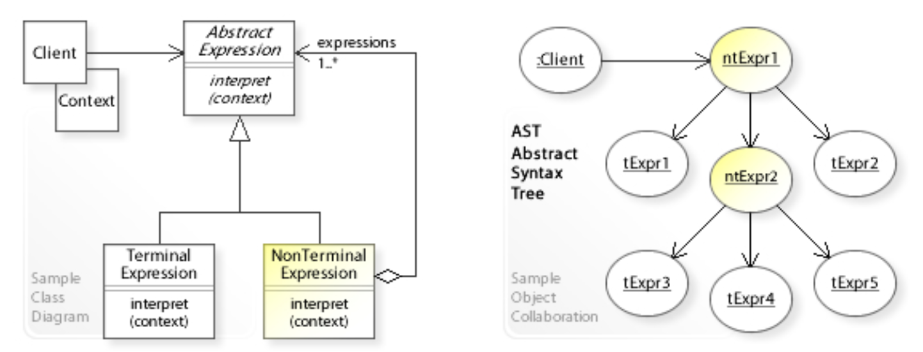
Interpreter
Given a language, define a representation for its grammar
along with an interpreter that uses the representation
to interpret sentences in the language.

Slide 42
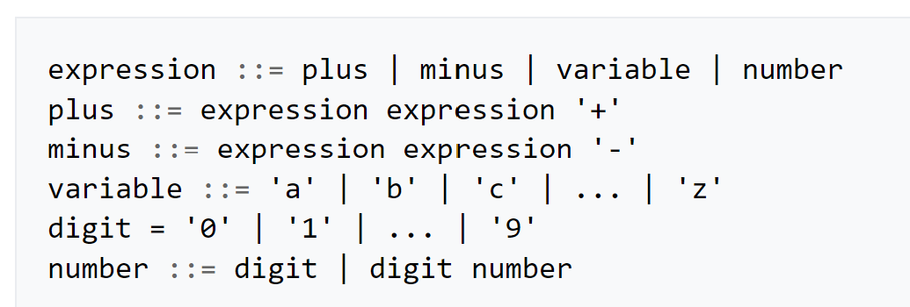
Example of Interpreter : Math Expression
abstract class Expression {}
class NumberExpression extends Expression {
double value;
}
class VariableExpression extends Expression {
String name;
}
class BinaryOperationExpression extends Expression {
Expression leftOperand;
String operator;
Expression rightOperand;
}

Slide 43
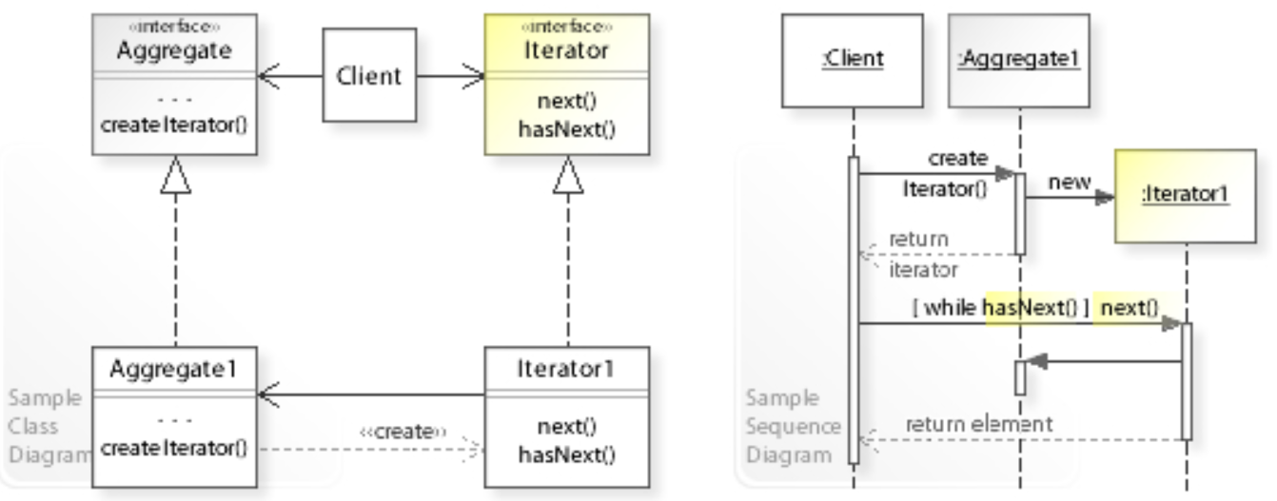
Iterator
Provide a way to access the elementsof an aggregate object sequentially
without exposing its underlying representation.

Slide 44
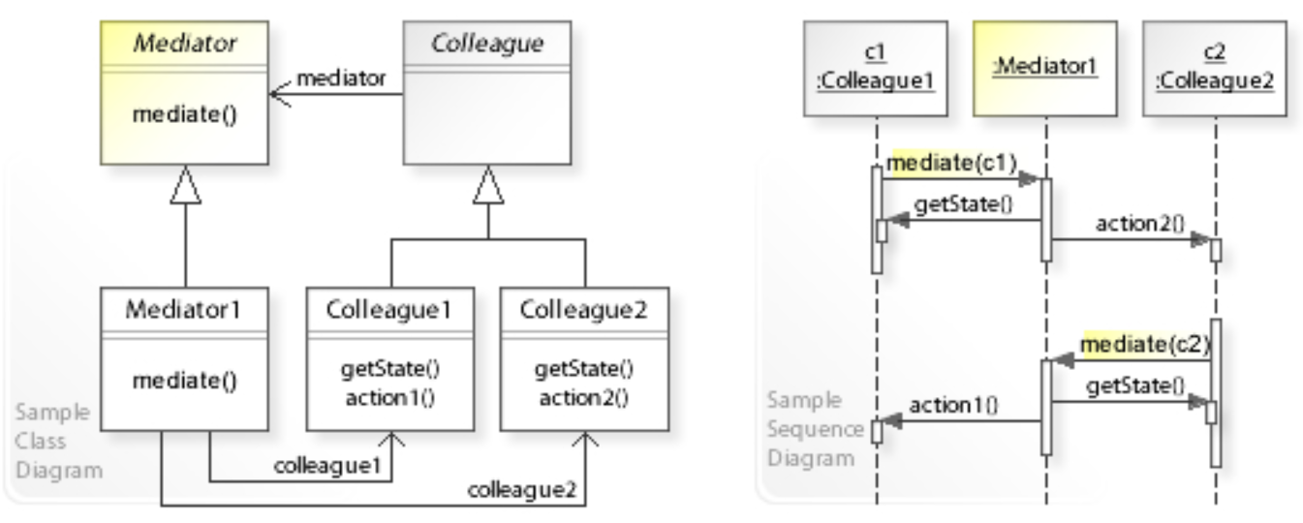
Mediator
Define an object that encapsulates how a set of objects interact.
Mediator promotes loose coupling
by keeping objects from referring to each other explicitly,
and it allows their interaction to vary independently.

Slide 45
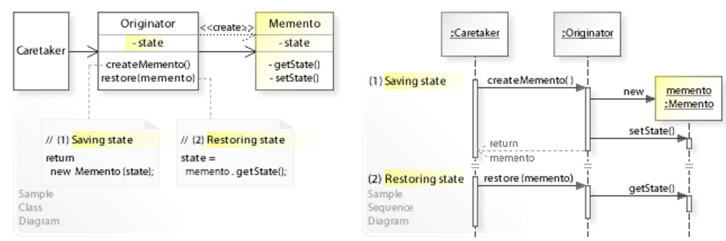
Memento
Without violating encapsulation,
capture and externalize an object's internal state
allowing the object to be restored to this state later.

Slide 46
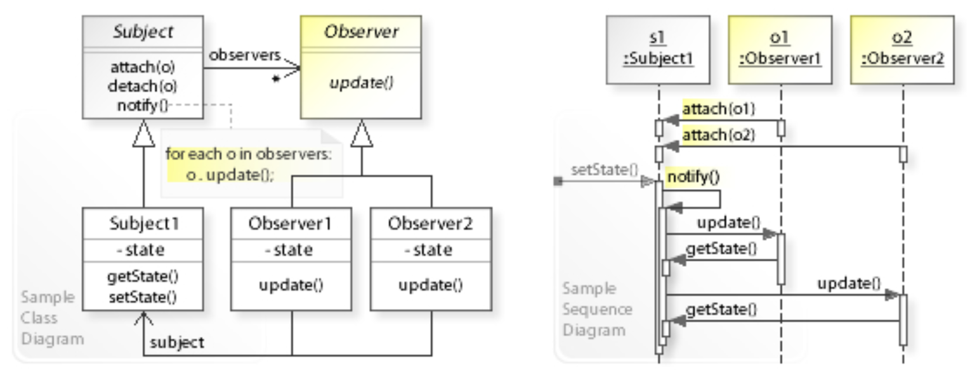
Observer
Define a one-to-many dependency between objects where a state change in one object
results in all its dependents being notified and updated automatically.

Slide 47
Synonyms:
Publish & Subscribe
Notifier Model – View (- Controller)
Event Sender
Message Sender
Emitter Reactive Object

Slide 48
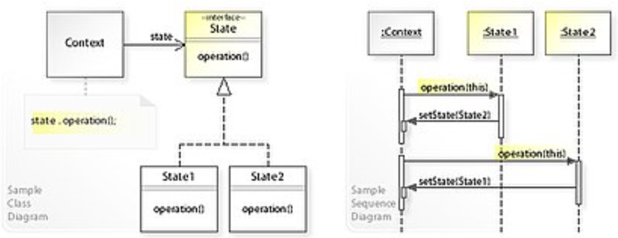
State
Allow an object to alter its behavior when its internal state changes.
The object will appear to change its class

Slide 49
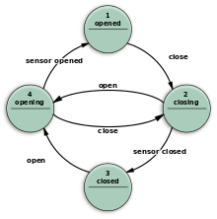
Example State 1 class per state Automaton (Deterministe) Finite State Machine ((D)FSM, FSA)
Abstract class State {
…
}
class Opened extends State {
}
class Opening extends State {
}
class Closing extends State {
}
class Closed extends State {
}

Slide 50
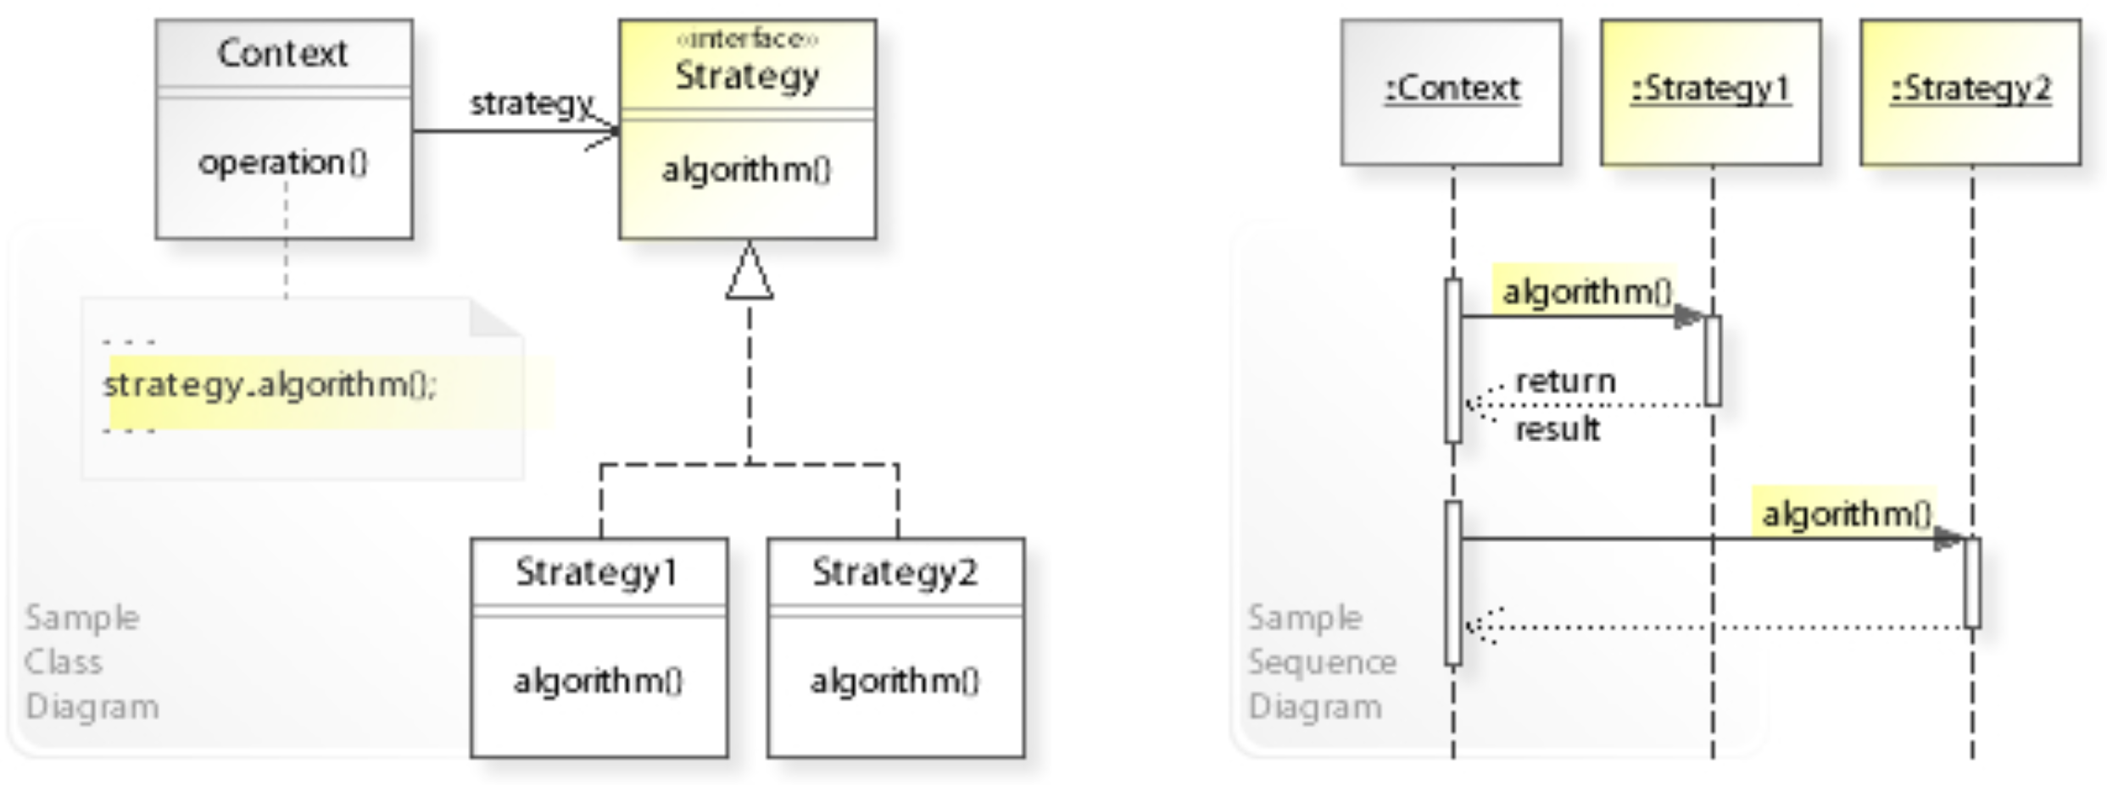
Strategy
Define a family of algorithms, encapsulate each one, and make them interchangeable.
Strategy lets the algorithm vary independently from clients that use it.

Slide 51
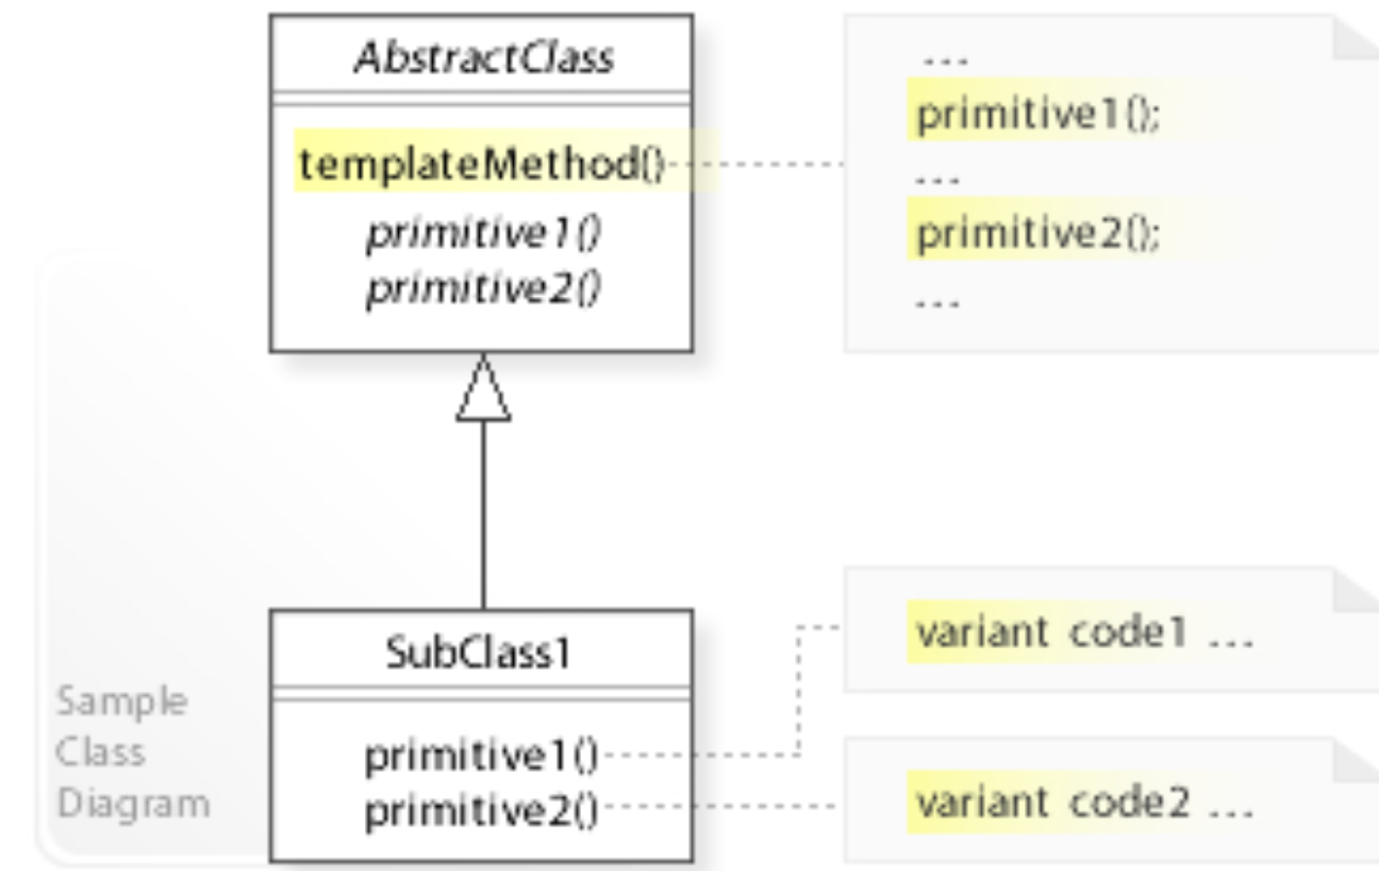
Template Method
Define the skeleton of an algorithm in an operation, deferring some steps to subclasses.
Template method lets subclasses redefine certain steps of an algorithm
without changing the algorithm's structure.

Slide 52
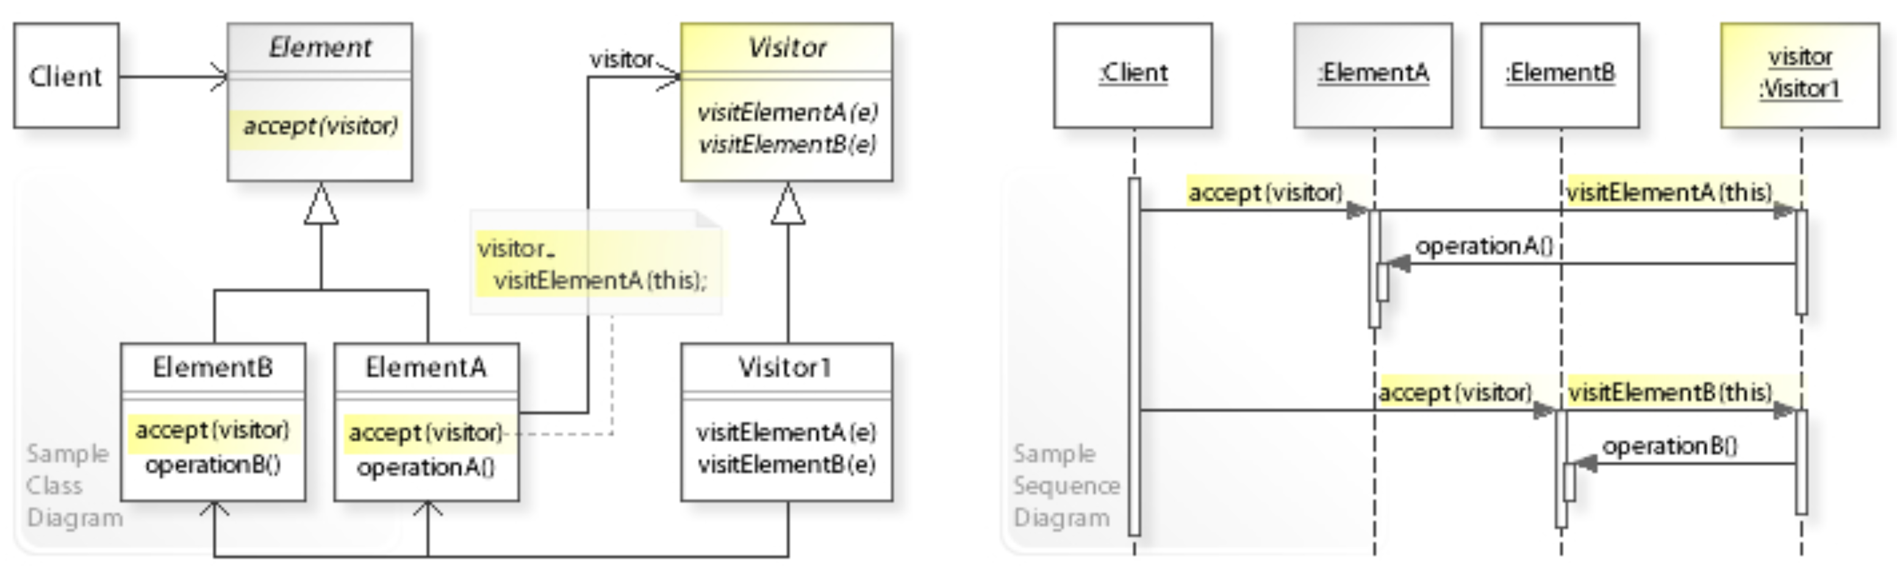
Visitor
Represent an operation to be performed on instances of a set of classes.
Visitor lets a new operation be defined without changing the classes of the elements on which it operates.

Slide 53
Example Visitor
Used in almost all Compilers, AST, Interpreter
(example javac, Eclipse AST)
For all Compile Phases
abstract class ASTNode {
public abstract void accept(Visitor v);
}
abstract class FooNode extends ASTNode {
@Override public void accept(Visitor v) {
v.visitFoo(this); }
}
abstract class Visitor {
public abstract void visitFoo(FooNode p);
public abstract void visitBar(BarNode p);
public abstract void visitBaz(BazNode p);
}

Slide 54
Using Visitor ..
class XXXVisitor extends Visitor {
private int xxxResult;
@Override
public void visitFoo(FooNode p) {...}
@Override
public void visitBar(BarNode p) {...}
@Override
public void visitBaz(BazNode p) {...}
}
ASTNode node = …
XXXVisitor visitor = new XXXVisitor();
node.accept(visitor);
int xxxResult = Visitor.getXXXResult();

Slide 55
Note on Visitor
Method « accept() » => does « switch »
method « visit() » => does the « case », usually calling recursing «so visiting tree »
Very efficiently : using virtual table of abstract class
… much more efficient than
if (x instanceof Foo) {
caseFoo((Foo) x);
} else if (x instanceof Bar) {
caseBar((Bar) x);
} …

Slide 56
Fluent Interface
Design an API to be method chained so that it reads like a DSL.
Each method call returns a context through which the next logical method call(s) are made available.
No UML diagram … depends of the DSL

Slide 57
Example Fluent Interface: lombok @Builder
@Builder
class A {
private int field1, field2;
}
// ➔
class Builder {
private int field1, field2;
public Builder field1(int p) {
this.field1 = p;
return this;
}
public Builder field1(int p) {
this.field1 = p;
return this;
}
public A build() {…}
}
A a = A.builder() .field1 ( 10 )
.field2 (20 )
.build();

Slide 58
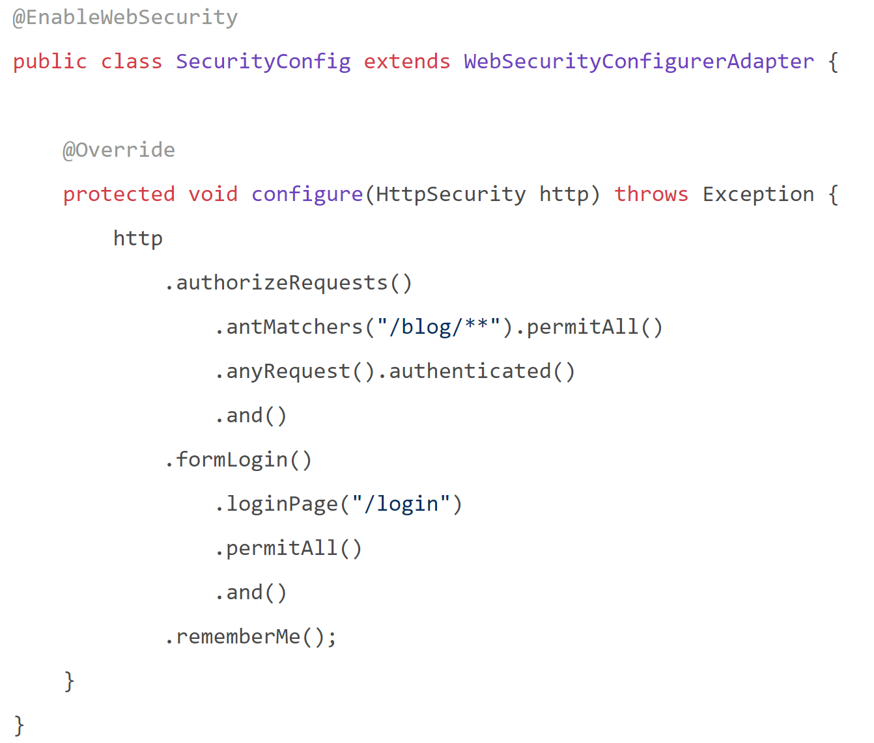
Example Fluent interfaces… Springboot conf https://spring.io/blog/2019/11/21/spring-security-lambda-dsl

Slide 59
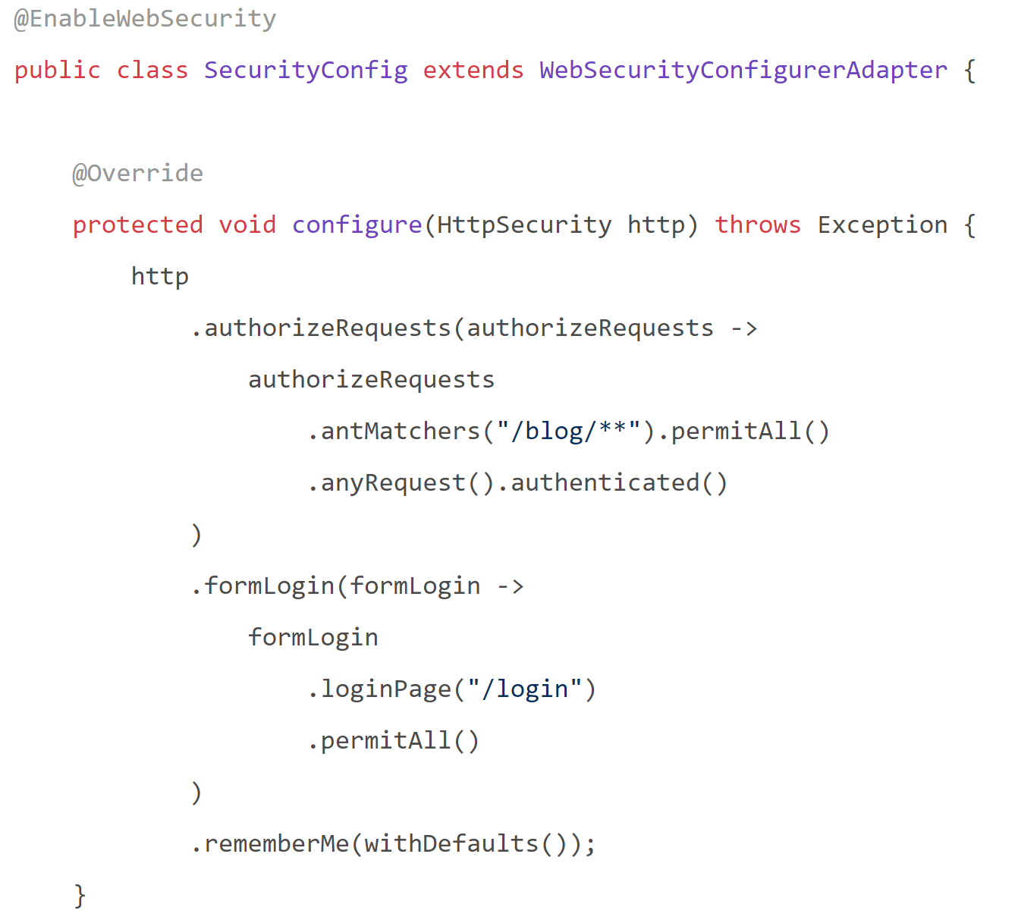
SpringBoot also use DSL + Callback …simpler no push / pop context (cf « .and() »)

Slide 60

How many design patterns in previous Slide?

Slide 61
HINTS … Design pattern…
It uses Dependency Injection
DSL
Class name is suffixed « Adapter », but is it?
Maybe also a « Template method»
« http » param is a Builder, also « authorizeRequests », « formLogin »?
Using Functional interface, to delegates
Authorizations use chain of responsibility
Some authorization are adater/bridges using ant patterns
rememberMe looks like a Memento
Etc…

Slide 62
Questions ?

